Slide 1
APPLIED DATA SCIENCE
MODEL DEPLOYMENT
GROUP 4

Slide 2
INTRODUCTION
Taking an ML model into a live environment (an existing production), where the model predicts outcomes based on real-world data, is known as model deployment. Most organizations, irrespective of their size, will have an existing DevOps process with which you need to integrate your MLOps process.

Slide 3
SAVE THE BEST MODEL
Callback to save the Keras model or model weights at some frequency. ModelCheckpoint callback is used in conjunction with training using model. fit() to save a model or weights (in a checkpoint file) at some interval, so the model or weights can be loaded later to continue the training from the state saved.

Slide 4
INTEGRATE WITH WEB FRAMEWORK
The integration framework helps you to integrate application data with other applications, either within your enterprise or with external systems. The framework includes predefined content that enables integration with a number of business objects, and a tool kit that you can use to extend predefined integration content and to develop new integration points.

Slide 5
The integration framework includes the following components and features:
Predefined integration content
Applications to create and configure integration components
Support for multiple communication modes including web services, hyper text transfer protocol (HTTP), and Java Message Service (JMS) messaging
Support for different data formats, including database interface tables, XML and JavaScript Object Notation (JSON) messages, and flat files such as comma-separated text files
Event-based, batch, program-initiated, and user-initiated processing and context-based launch of external applications
Support for integration to operational management products (OMPs)
Support for clustered environments
Support for interacting with applications that support the Open Services for Lifecycle Collaboration (OSLC) integration specification. The integration framework can enable an application to be an OSLC consumer application that can integrate with an external application that has implemented OSLC provider capabilities.
Support for API keys for machine-to-machine integrations.

Slide 6
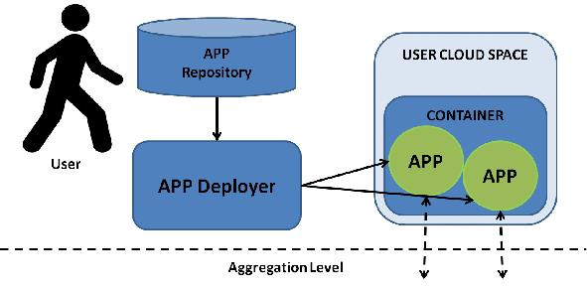
RUN THE APPLICATION

